Slide 1
Electricity measuring system
Team Pi-sense
Lochana Abhayawardana, Arsany Girgis and Emirkan Sali

Slide 2
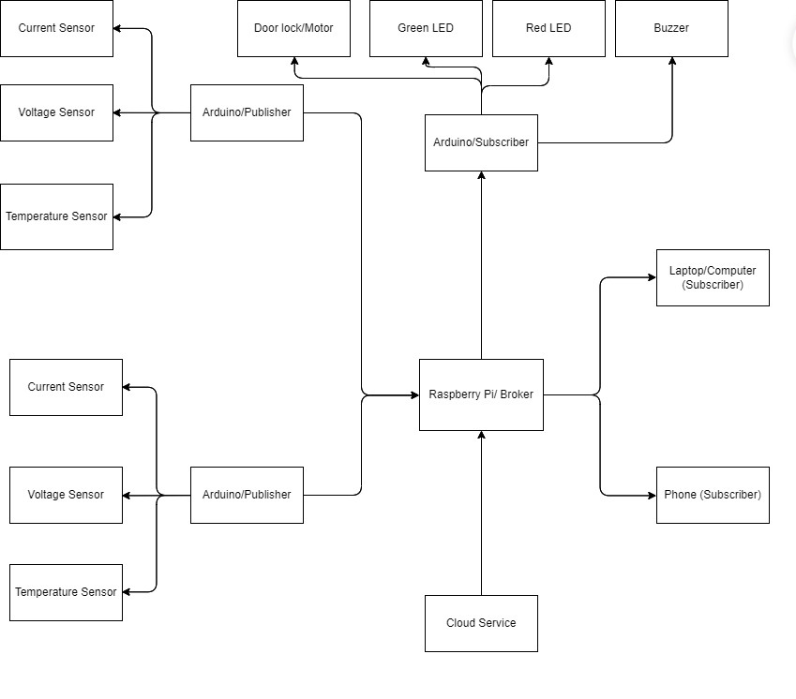
Concept

Slide 3
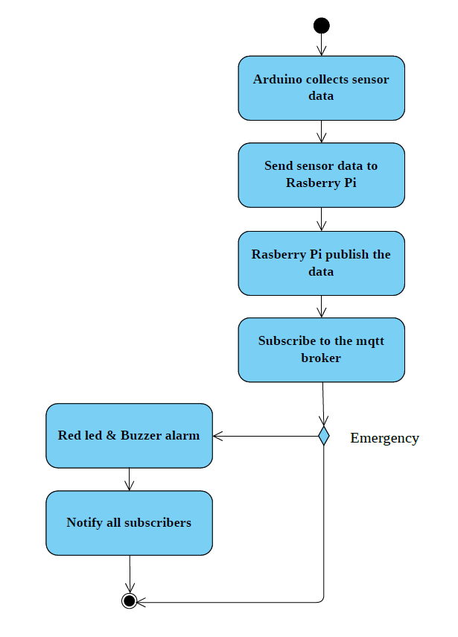
Concept

Slide 4
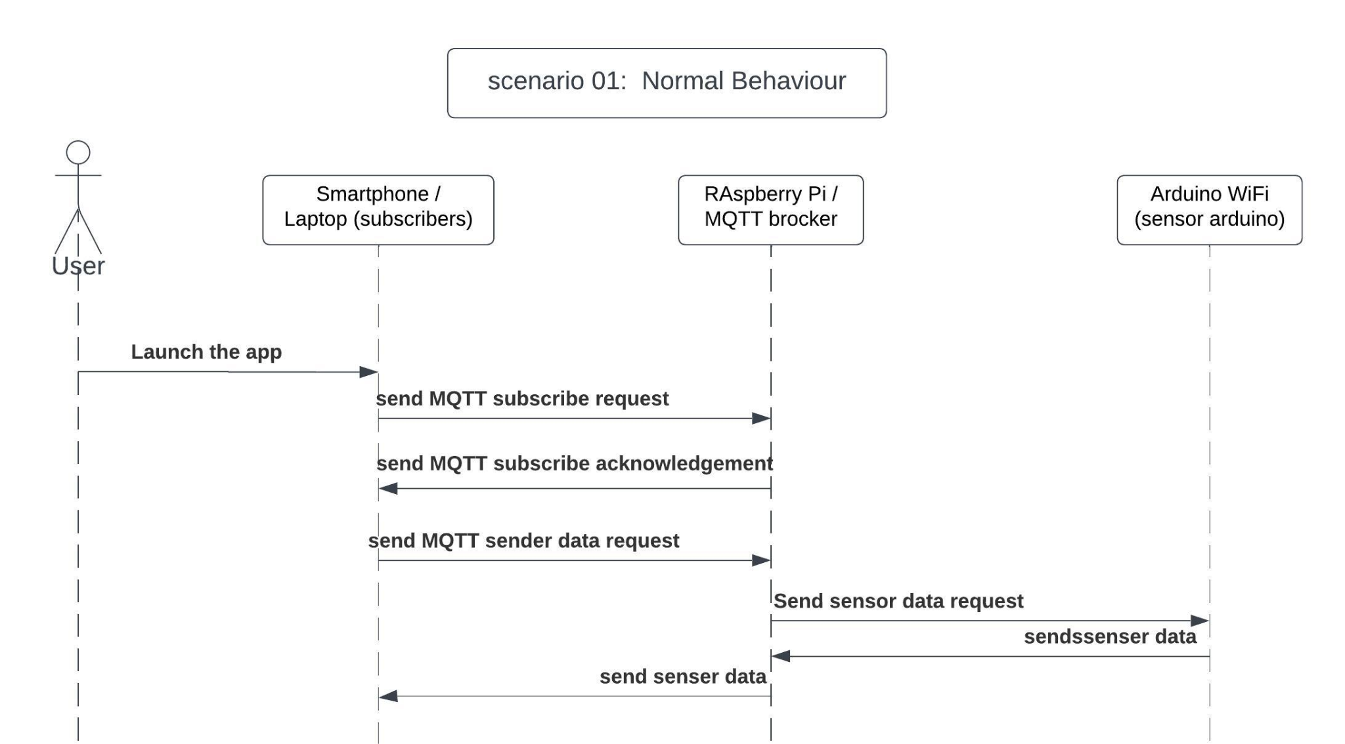
Concept

Slide 5
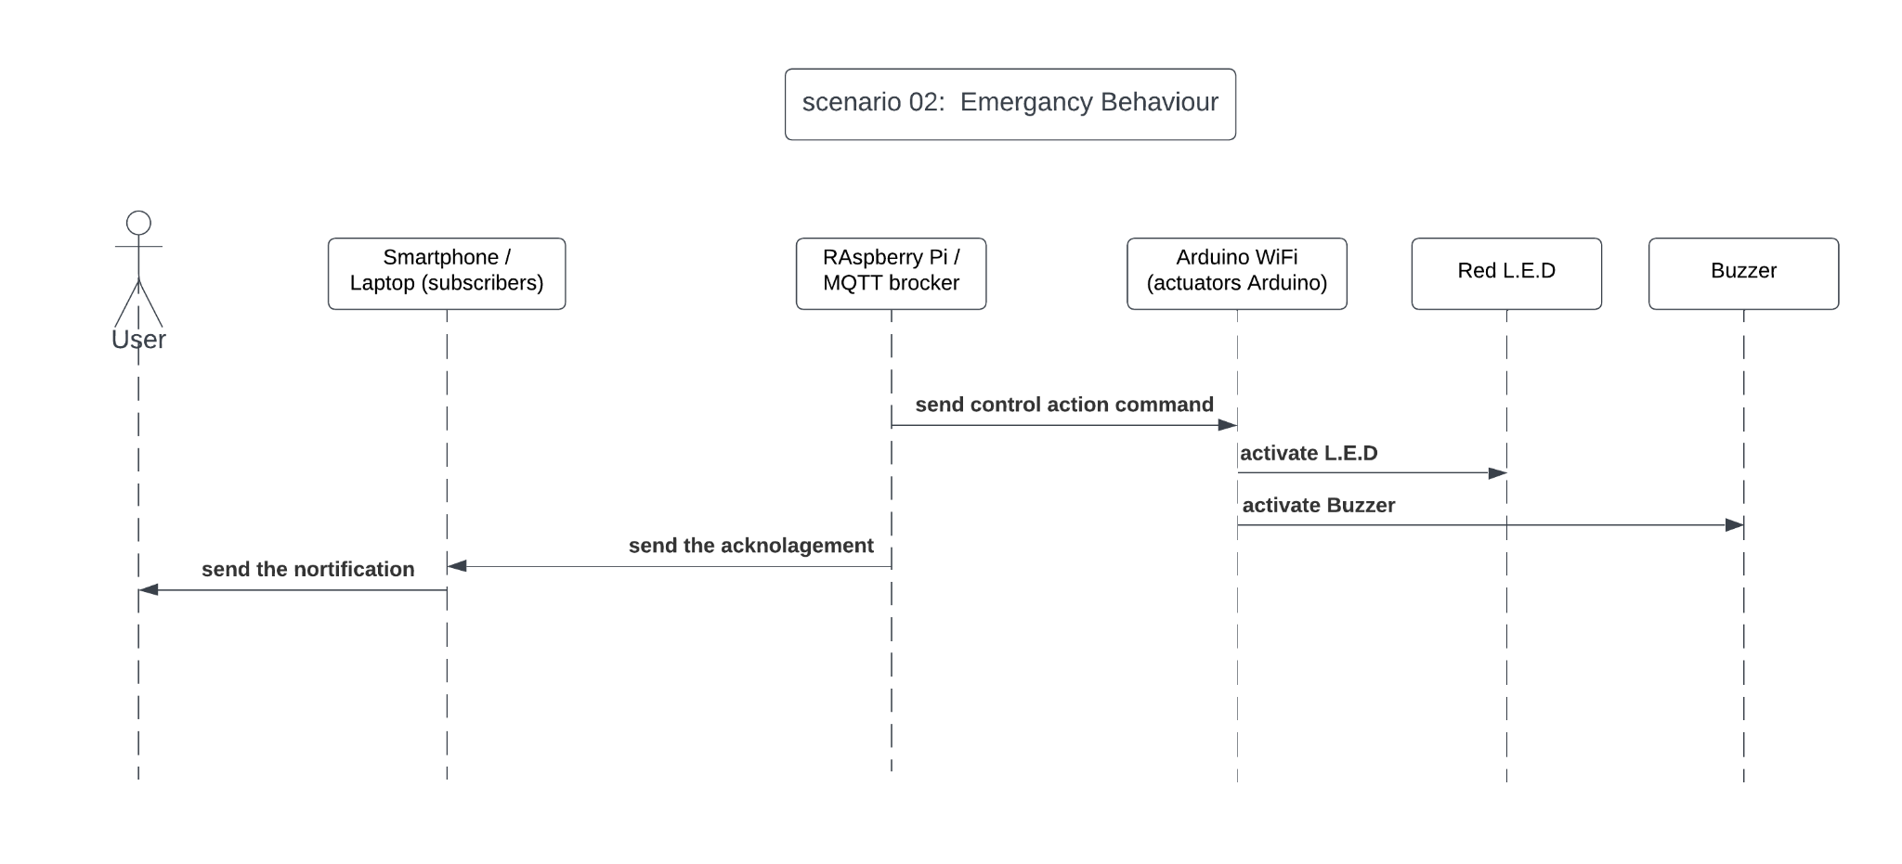
Concept

Slide 6
Implementation of sensors and actuators
Setting up variables for Voltage, Current, temperature and Servo
Choosing the right resistors for our voltage sensor
Sensors connected to analog pins
Creating the right functions for the sensors
Setting up code for triggering an alarm and moving the Servo

Slide 7
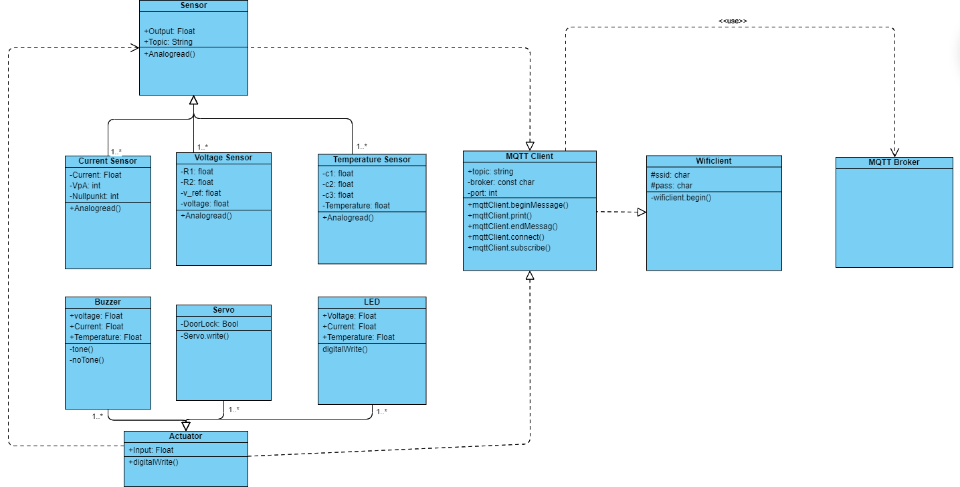
Class diagram of our system

Slide 8
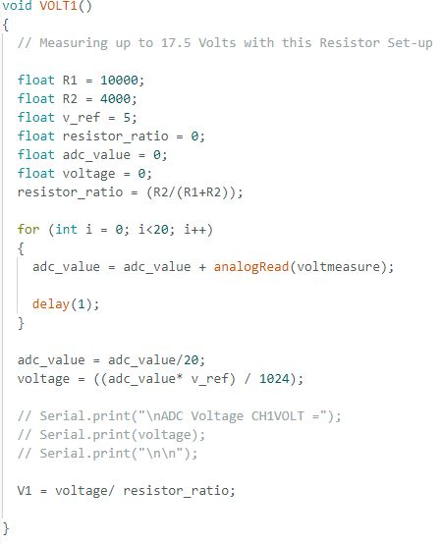
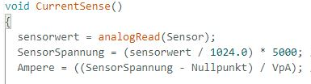
Measuring current and voltage

Slide 9
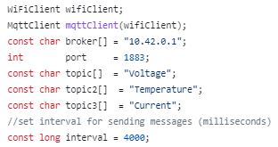
MQTT implementation
Initialisation

Slide 10
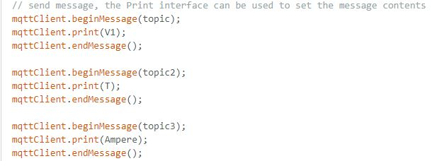
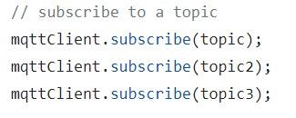
Publisher
2. Subscriber

Slide 11
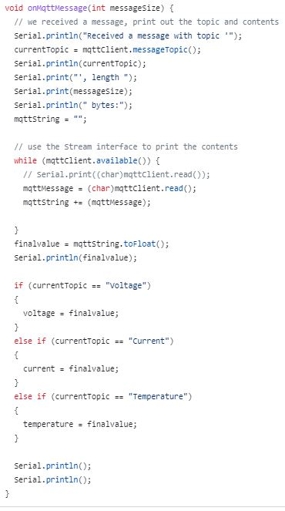

Slide 12
MQTT in Arduino
Using library “ArduinoMqttClient”
Setting important variables for connecting to broker
Connecting to the Raspberry Pi Wi-Fi and to the broker
Sending or receiving messages

Slide 13
Conclusion
Concept of an reliable IoT electricity measuring system applicable in industrial environments
Using Actuator and Sensor Device for the prototype and a Raspberry Pi
Using MQTT, establishing a network with actuators, sensors and a broker
Implementing MQTT on the Arduinos and Raspberry Pi
Final design possibility would include more sensitive Current sensor and industrial screw NTC Thermistor

Slide 14

Demo for our system

